Slide 1
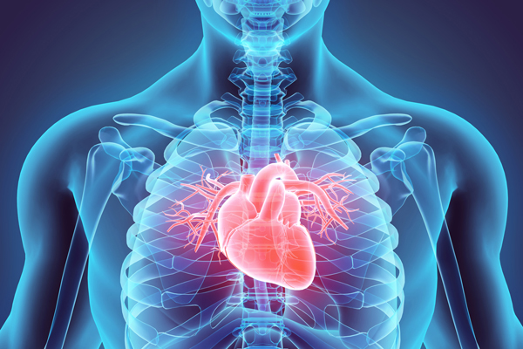
HEART disease
BY
Sumithra HariGuruprasad

Slide 2
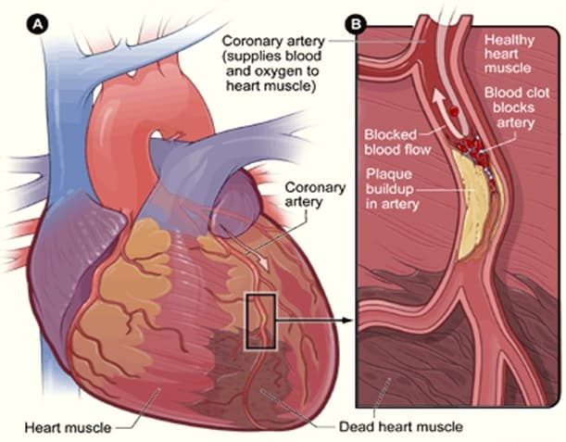
Introduction
Heart disease, also known as ischemic heart disease or coronary heart disease.
Heart disease refers to the build up of plaque in the heart's arteries that could lead to a heart attack, heart failure or death.

Slide 3
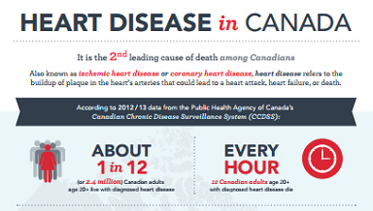
According to WHO 17.9 million people die from Cardio Vascular disease that is 31% all global deaths.
Also Public Health Agency of Canada (PHAC) reports that heart disease is the 2nd leading cause of death in Canada.
About 1 in 12 (or 2.4 million) Canadian adults age 20 and over live with diagnosed heart disease.
Every hour about 12 Canadian adults age 20 and over with diagnosed heart disease die.

Slide 4
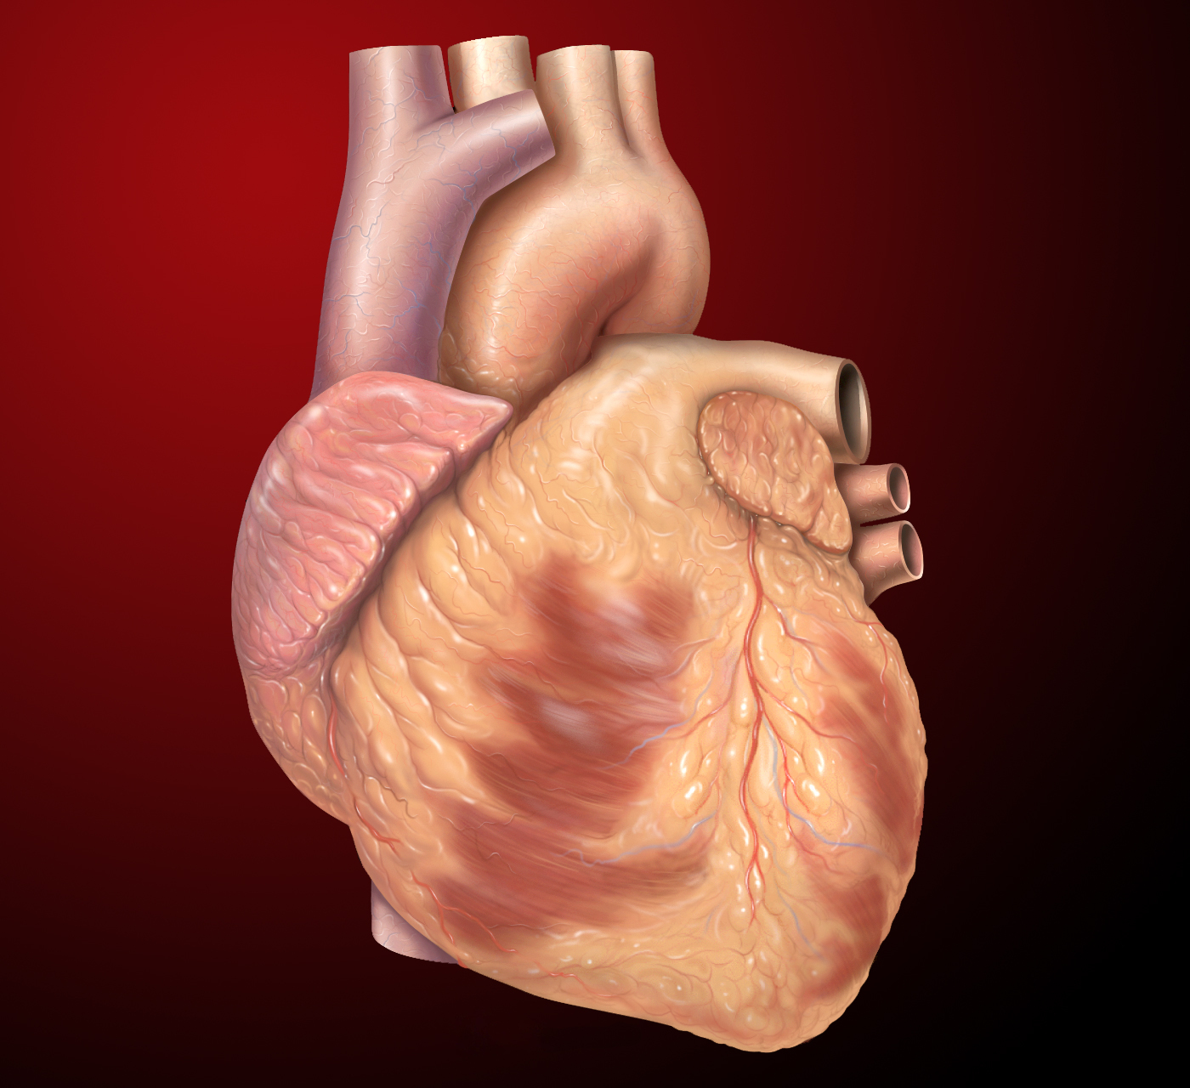
The early detection and management of medical conditions such as high blood pressure, diabetes and high cholesterol can help us in making decisions on lifestyle changes in high risk patients and in turn reduce the complications.
Here we have the dataset which is a part of the Heart Disease Data Set obtained from the Cleveland Clinic Foundation using a subset of 14 attributes.
Based on our analysis we intend to pinpoint the most relevant/risk factors of heart disease as well as create a model to predict the chance of having heart diseases in people to the maximum accuracy.

Slide 5

'age', 'sex', 'cp', 'trestbps', 'chol', 'fbs', 'restecg', 'thalach', 'exang', 'oldpeak', 'slope', 'ca', 'thal', 'target'
Features
Categorical Variables
Continuous Variables
Sex
Cp
Fbs
Restecg
Exang
Slope
Ca
Thal
Target
Age
Trestbps
Chol
Oldpeak
Thalach

Slide 6
Features Analysis
Continuous Variables
Age
age in years
Trestbps
resting blood pressure (in mm Hg on admission to the hospital)
Chol
serum cholesterol in mg/dl
Oldpeak
ST depression induced by exercise relative to rest
Thalach
maximum heart rate achieved

Slide 7
Categorical Variables
Sex
1 - male ; 0 - female
Cp: chest pain
3: typical angina 2: non-anginal pain 1: atypical angina 0: asymptomatic
Fbs: fasting blood sugar
fbs > 120 mg/dl (1 : true; 0 :false)
Restecg: resting
electrocardiographic results
2: having ST-T wave abnormality 1: normal
0: showing probable or definite left ventricular hypertrophy
Slope : the slope of the peak
exercise ST segment
2: upsloping 1: flat 0: down sloping
Exang :exercise induced angina
1 : yes; 0 : no
Ca : number of major vessels
ca: (0-3) colored by fluoroscopy
Thal : thalium stress test result
3 : reversable defect; 2: normal; 1: fixed defect; 0: missing values
Target:: diagnosis of heart disease
1: No heart disease , 0: Heart disease

Slide 8
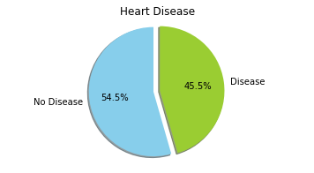


Young
0%
25%
Middle aged
11%
Old
38%
Young
43%
55%
Middle aged
41%
Old
70%
The dataset has 32% women and 68% men.
Out of total women 25% and out of total men 55% have heart disease.
The rate of heart disease in men is more than in women in all age groups.
The minimum age of the Patient is 29 and the maximum age is 77.
People over the range of 55-65 of age are more likely to have heart disease.

Slide 9
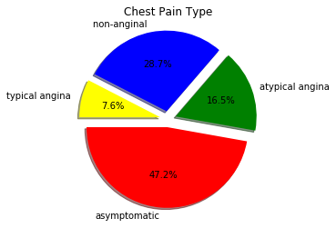
3: Chest pain related to decrease in blood supply to the heart
2: Non heart related pain
1: Chest pain not related to heart
0: Chest pain not showing signs of disease
From our observation chest pain type 0 are common with heart disease.
There are 72% who heart disease have chest pain type 0 compared to 30% who have chest pain type 3.
There are significant number of people with chest pain type 0 who have heart disease where
number of major vessels is 0,
exercise induced angina is true ,
trestbps is between 110-150 and
cholesterol level is between 200-300 mg/dl
In general women and men who have chest pain 0 have more chance of having heart disease.

Slide 10
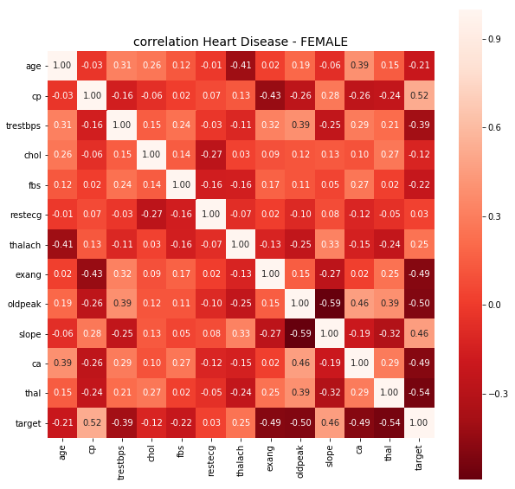
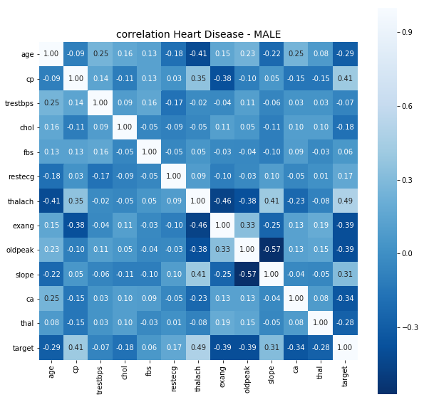
Correlation of female with all the features - chest pain type and slope, thalach, oldpeak, exang have a more significant correlation with heart disease in women
Correlation male with all the features - thal has a more significant correlation with heart disease in men than chest pain type.
Overall there is not much of correlation between the features.

Slide 11
Predictive Modelling Approach
Scaling used for Continuous Variables
Dummy variables created for Categorical Variables
Split the dataset in Train and Test (70-30)
Models
Logistic Regression
Naïve Bayes
Notes:
No variables dropped
No outliers, missing values replaced

Slide 12
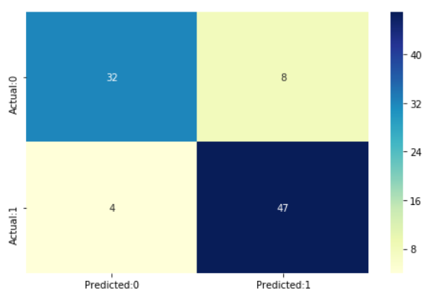
Model 1: Logistic regression
Metrics:
Evaluation Accuracy: 0.858 Test Accuracy: 0.868 AUC: 0.86
 | Precision | Recall | F1-Score
Heart Disease | 0.89 | 0.80 | 0.91
No Heart Disease | 0.85 | 0.92 | 0.89
Avg/total | 0.87 | 0.87 | 0.87

Slide 13
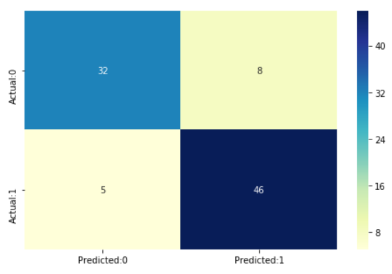
Model 2: naiVE bAYES
Metrics:
Evaluation Accuracy: 0.806 Test Accuracy: 0.857 AUC: 0.85
 | Precision | Recall | F1-Score
Heart Disease | 0.86 | 0.80 | 0.83
No Heart Disease | 0.85 | 0.90 | 0.88
Avg/total | 0.86 | 0.86 | 0.86

Slide 14
Conclusion
Test Accuracy, Precision and AUC is slightly higher for the Logistic Regression Model. Model predicted with 0.86 accuracy and had a precision score of 89%.
9 variables out of 13 had a significant role in the Heart disease prediction. Top 4 variables are exercise induced angina, gender, slope and number of major vessels coloured by fluoroscopy.
4 variables that did not play a significant role in the prediction are: age, resting blood pressure, serum cholesterol and fasting blood sugar.

Slide 15
Thank you!

